Slide 1

Kameleon Plus IDL Wrapper
Freddie Romano

Slide 2

CCMC
CCMC Mission Statement
The CCMC is a multi-agency partnership to enable, support and perform the research and development for next-generation space science and space weather models.
  Test, evaluate, and provide access to space research models
  Support space Weather forecasting
  Support space science education

Slide 3

CCMC Kameleon Software
  Space weather model output varies in format
  Kameleon helps:
    Analyze and disseminate data
    Uniformly store output
      New files with both metadata and original model data
  With Kameleon Access and Interpolation Library
    Access model data and metadata
  User friendly interface to data
    Masks native complexity
  Option to access native tools and routines
  Supported Models:
    SWMF/BATSRUS
    OpenGGCM
    CTIP
    ENLIL
    MAS

Slide 4
IDL Wrapper for Kameleon
  Kameleon: C++
    But designed to be compatible with many programming languages:
      C
      Fortran
      Java
      Python
  Needed an IDL wrapper for Kameleon
  Tried in three ways:
    Java IDL bridge
    Built-in function CALL_EXTERNAL
    Dynamically Loadable Module (DLM)

Slide 5
CALL_EXTERNAL
  Calls routines from external library files
    Used library from Kameleon C wrapper
  Parameters
    Library file
    Routine to be called
    Variable type returned by routine
    Arguments to routine
    How each argument is passed
      Value vs Reference
  Unnecessarily complex
  Created several routines to perform grunt work
    Location of library
    Check typing of arguments
    Ensure arguments are passed correctly

Slide 6
CALL_EXTERNAL
  Strings handling
    C vs. IDL
    Created extra C functions to process IDL strings
      Originally no support for IDL strings in Kameleon
  Final product
    Easy to access Kameleon
    But large overhead
      Library loaded into IDL at every function call

Slide 7
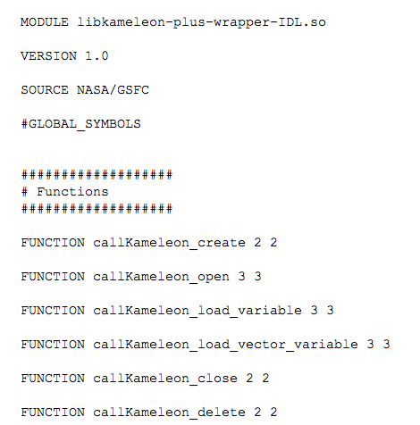
Dynamically Loadable Module (DLM)
  Load library of routines once during IDL session
    Even if different routines
  Faster than CALL_EXTERNAL
  Extensive support code
  IDL automatically searches for DLM's on startup
    Searches for a plain text .dlm file
    .dlm file contains name of library and list of routines to be loaded

Slide 8
Creating a DLM
  When a .dlm file is found, IDL makes note of the routines
    Loads them as stubs
    Does not load the library yet
  Routines only compatible if they accept/return IDL defined variables
  A new IDL-compatible routine was created for every Kameleon C routine
    These are the routines listed in the .dlm file
    Also hardcoded as a list into Kameleon source code

Slide 9
The DLM in action
  DLM routines not fully loaded on startup
    Waits until first call for a routine in library
    Library then loaded by searching for and executing IDL_Load function
      Loads routines from hard coded list
  If anything failed to load, IDL returns and issues an error
  Performance
    Downgrade in performance compared with Kameleon C wrapper (speed)
    Not nearly as severe as with CALL_EXTERNAL
  Otherwise
    Ready to go
    Kameleon is now accessible to IDL users

